Slide 1
Structural Design Patterns
A Type of Design Pattern
By-
Vivek
Praveen

Slide 2
TABLE OF CONTENTS
01
02
03
04
History of Design Pattern
Definition of design Pattern
Types of Design Pattern
Types of Structural design Pattern

Slide 3

History of Design Pattern
In 1994, Design Patterns: Elements of Reusable Object- Oriented Software by Erich Gamma, Richard Helm, Ralph Johnson and John Vlissides explained the usefulness of patterns and resulted in the widespread popularity of design patterns.
These four authors together are referred to as the Gang of Four (GoF).

Slide 4
Definition of design Pattern
“Design patterns represent solutions to frequent problems that arise when developing software within a particular context.”

Slide 5
Types of Design Patterns
Creational
Structural
Behavioural
Creational patterns deal with object creation mechanisms, trying to create objects in a manner suitable to the situation.
Structural patterns focus on class composition and object composition.
Behavioral patterns concentrate on communication between objects, how they interact and fulfill a given task.

Slide 6
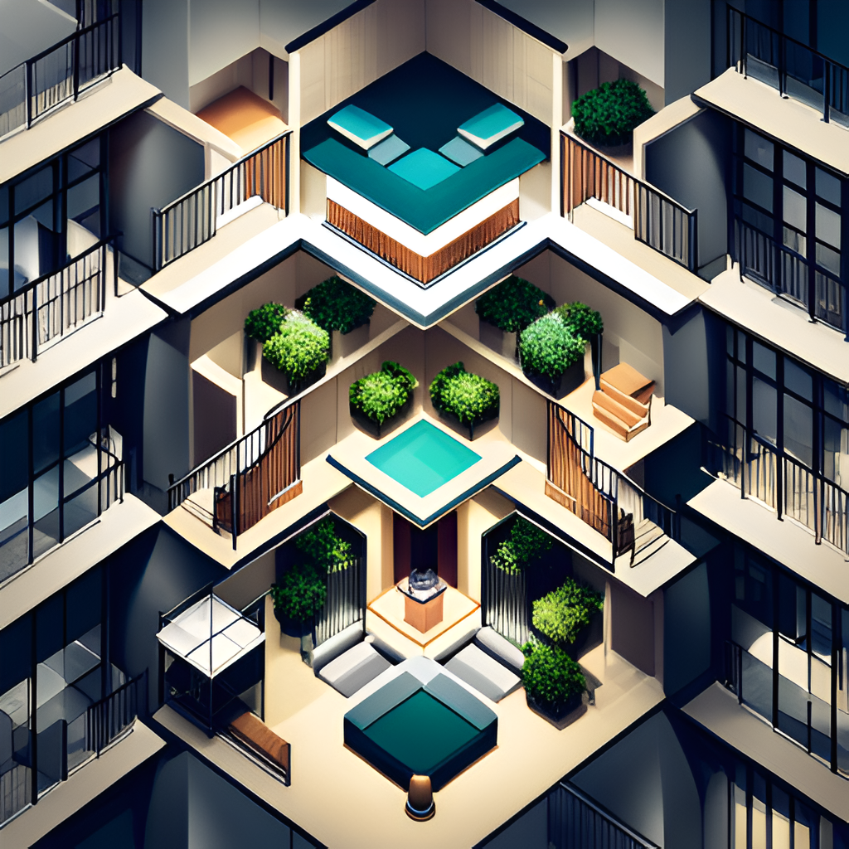
Types of Structural Design Pattern
Structural design patterns are a set of design patterns that focus on the structure of objects and classes. These patterns help developers create relationships between objects and classes, making it easier to reuse code and create flexible software systems.
Façade Design Pattern
Composite Design Pattern
Proxy Design Pattern
Decorator Design Pattern
Adaptor Design Pattern

Slide 7

Façade Design Pattern
Design Purpose
-The word facade means an artificial or false appearance of an object. Applied to programming, it similarly means providing another face – or rather, interface – to a complex set of objects.
Design Pattern Summary
- Define a single and simple interface for clients to use the functionality of the package.
The facade pattern is a structural design pattern that simplifies or Hide complexity sub-systems by providing a simplified interface. This pattern is useful when you have a complex system with many components and you want to provide a simple way to interact with it.
Practically, every Abstract Factory is a type of Facade.

Slide 8
Advantage of Facade Pattern
It shields the clients from the complexities of the sub-system components.
It promotes loose coupling between subsystems and its clients.

Slide 9
Usage of Facade pattern:
When you want to provide simple interface to a complex sub-system.
When several dependencies exist between clients and the implementation classes of an abstraction.

Slide 10
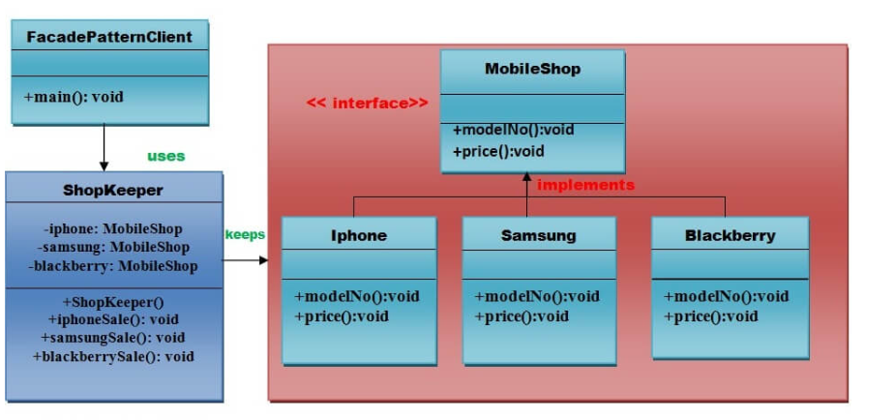

Example of Facade Pattern

Slide 11
Composite Design Pattern
Design Pattern Summary
- This pattern deals with a tree-like structure of objects. In this tree, the individual object, or even the entire hierarchy, is treated the same way.
The composite pattern is a structural design pattern that allows you to treat groups of objects as if they were individual objects. This pattern is useful when you have a hierarchical structure of objects and you want to treat them all in the same way.

Slide 12
Usage of Composite pattern:
Composite pattern should be applied only when the group of objects should behave as the single object.
Composite design pattern can be used to create a tree like structure.

Slide 13
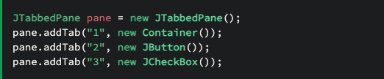
Composite Example
Nested containers in AWT/Swing are great examples of usages of the composite pattern in core Java. The java.awt.Container object is basically a root component that can contain other components, forming a tree structure of nested components.
All the classes used here – namely, JTabbedPane, JButton, JCheckBox, and JFrame – are descendants of Container.

Slide 14
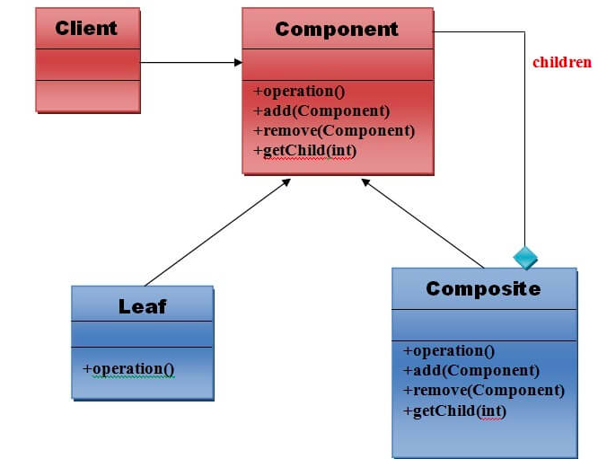
Composite Pattern Structure

Slide 15
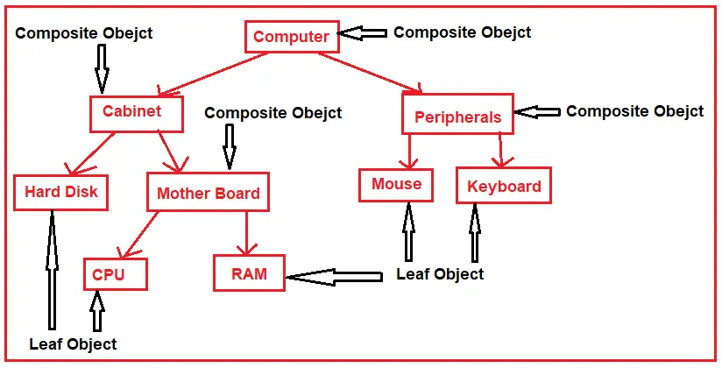
Composite Pattern Example

Slide 16
Proxy Design Pattern
Design Pattern Summary
-This pattern offers a proxy, or a substitute, to another complex object. While it sounds similar to a facade, it's actually different in the sense that a facade offers a different interface to the client to interact with. In the case of a proxy, the interface is the same as that of the object it hides.
The proxy pattern is a structural design pattern that provides a placeholder for another object. This pattern is useful when you want to control access to an object or when you want to delay the creation of an object until it's actually needed.

Slide 17
Types of proxies
Remote proxy: They are responsible for representing the object located remotely. Talking to the real object might involve marshalling and unmarshalling of data and talking to the remote object. All that logic is encapsulated in these proxies and the client application need not worry about them.
Virtual proxy:
These proxies will provide some default and instant results if the real object is supposed to take some time to produce results. These proxies initiate the operation on real objects and provide a default result to the application. Once the real object is done, these proxies push the actual data to the client where it has provided dummy data earlier.
Protection proxy:
If an application does not have access to some resource then such proxies will talk to the objects in applications that have access to that resource and then get the result back.
Smart Proxy:
A smart proxy provides additional layer of security by interposing specific actions when the object is accessed. An example can be to check if the real object is locked before it is accessed to ensure that no other object can change it.

Slide 18
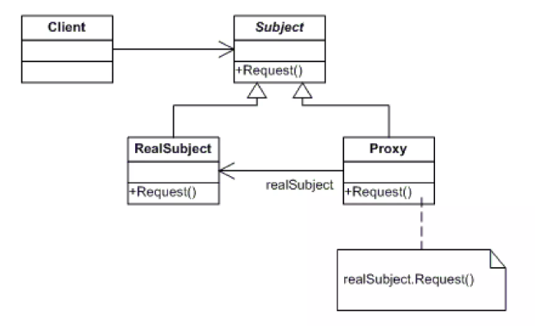
Proxy Pattern Example

Slide 19
Adapter Pattern
An Adapter Pattern says that just "converts the interface of a class into another interface that a client wants".

Slide 20
In other words, to provide the interface according to client requirement while using the services of a class with a different interface.
The Adapter Pattern is also known as Wrapper.

Slide 21
Usage of Adapter pattern:
When an object needs to utilize an existing class with an incompatible interface.
When you want to create a reusable class that cooperates with classes which don't have compatible interfaces.
When you want to create a reusable class that cooperates with classes which don't have compatible interfaces.

Slide 22
Advantage of Adapter Pattern
It allows two or more previously incompatible objects to interact.
It allows reusability of existing functionality.

Slide 23
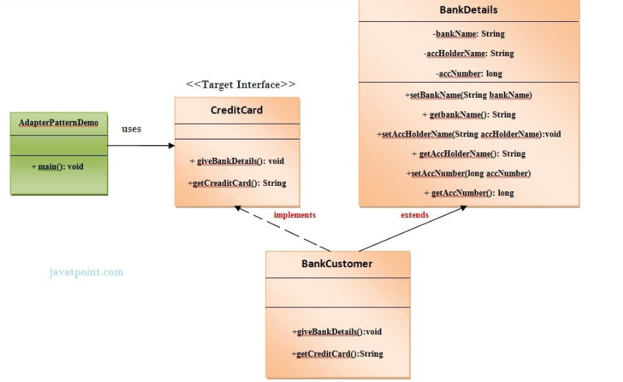
Example of Adapter Pattern

Slide 24
Decorator Pattern
A Decorator Pattern says that just "attach a flexible additional responsibilities to an object dynamically".

Slide 25
In other words, The Decorator Pattern uses composition instead of inheritance to extend the functionality of an object at runtime.
The Decorator Pattern is also known as Wrapper.

Slide 26
Advantage of Decorator Pattern
It provides greater flexibility than static inheritance.
It enhances the extensibility of the object, because changes are made by coding new classes.
It simplifies the coding by allowing you to develop a series of functionality from targeted classes instead of coding all of the behavior into the object.

Slide 27
Usage of Decorator pattern:
When you want to transparently and dynamically add responsibilities to objects without affecting other objects.
When you want to add responsibilities to an object that you may want to change in future.
Extending functionality by sub-classing is no longer practical.

Slide 28
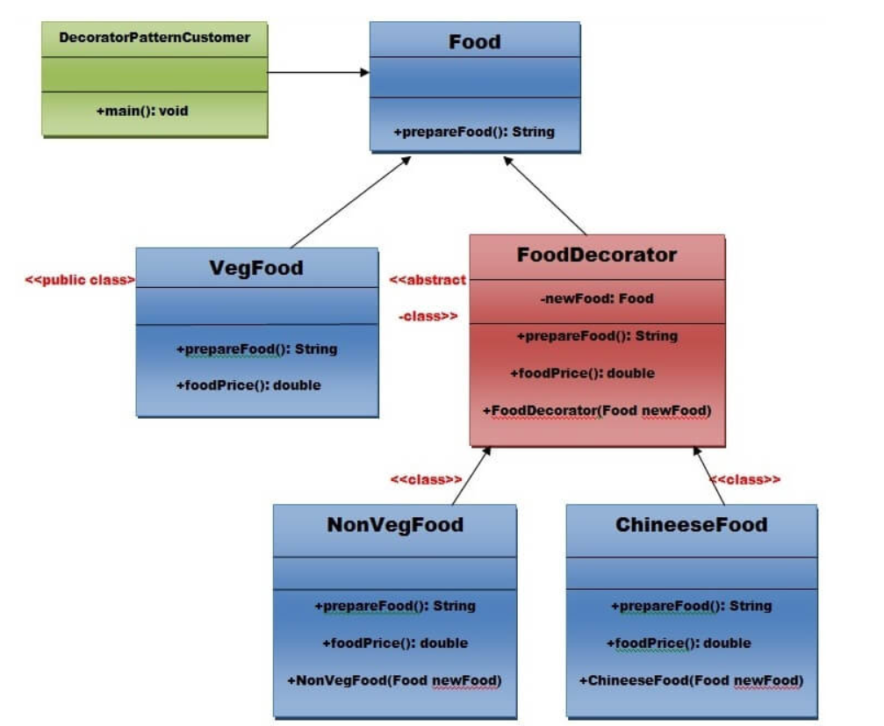
Example of Decorator Pattern

Slide 29
THANKS!

